Slide 1

CUSTOMER PREDICTION
BA – Technology, Data & Insight

Slide 2
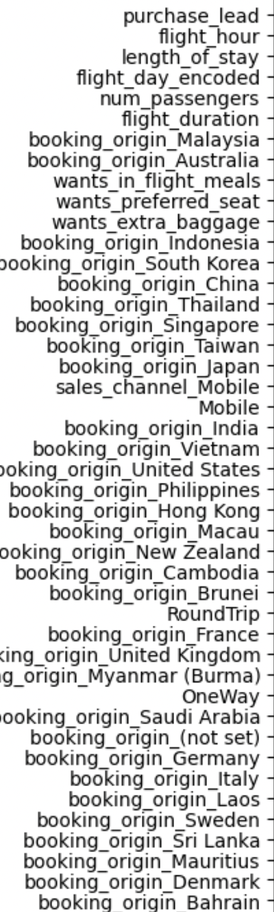
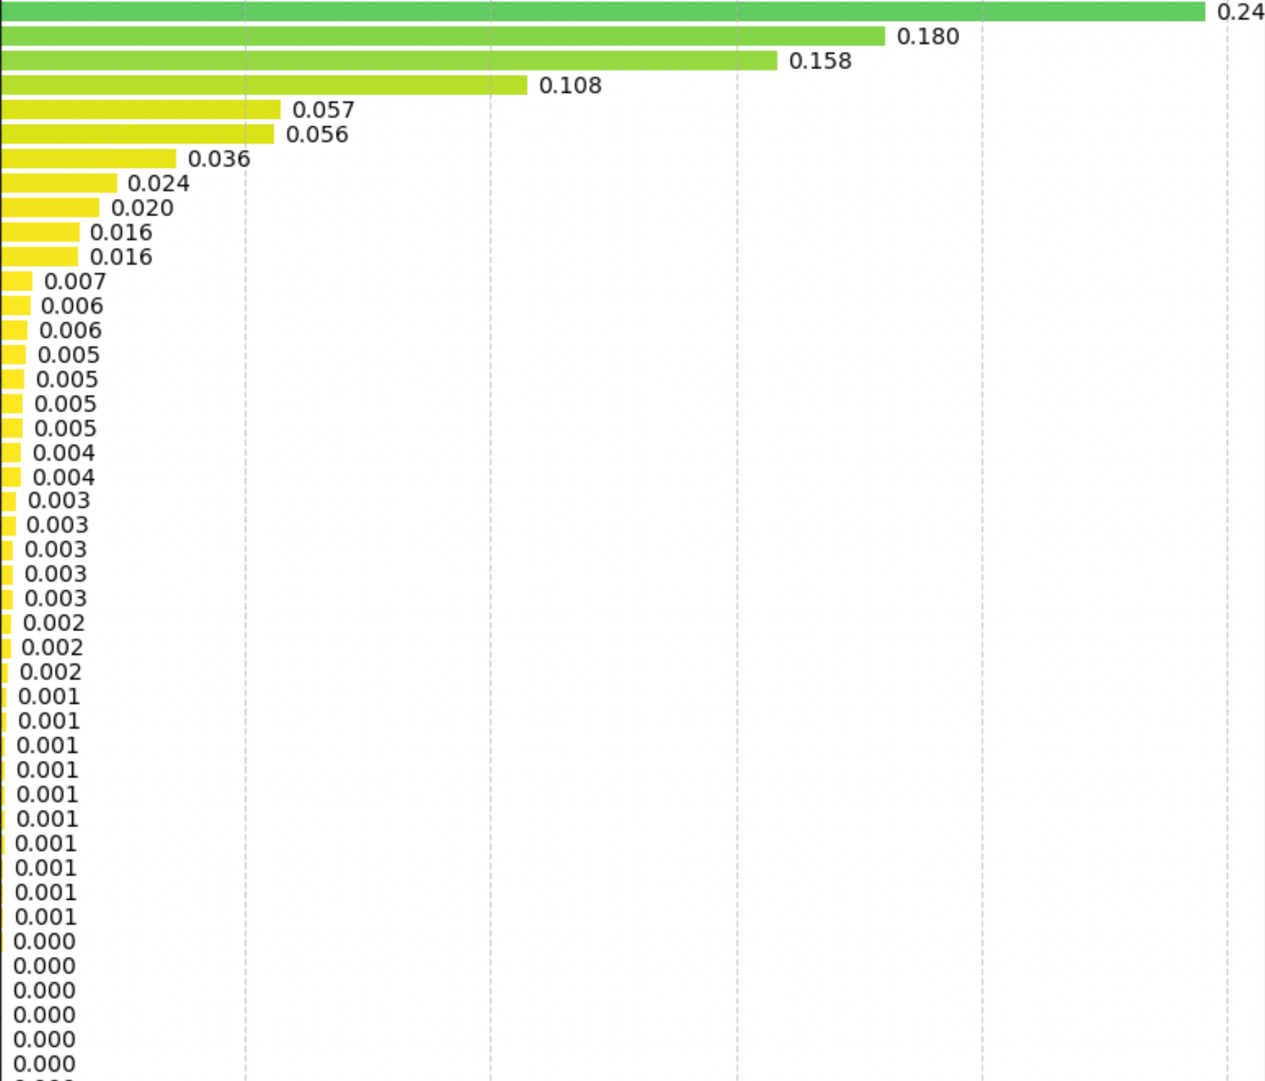
RESULTS
Evaluation
The most important variable in the model was purchase_lead, that is the time between purchase and departure.
Information about the flight, e.g. flight time and duration was also significant, however booking origin of the customer was not important.
Accuracy of the model was approximately 0.6 (Precision) and 0.01 (Recall), showing that this model requires more improvement. I suggest adding more customer-centric features into the model.
Feature Importance

